Slide 1
Project Update
Ashlee Campbell, Benjamin Sanda, Chad Banfield, Zachary Aebersold, Kyle Stevenson

Slide 2
Project Summary
Our goal for the semester project is to update the website for Perfect Paws Pet Salon in Plymouth, as well as create a database for them to store customer information and previous transactions.

Slide 3

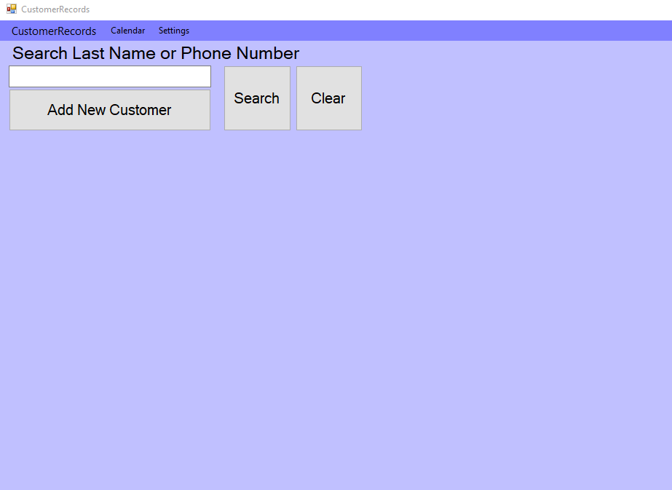
Start Screen

Slide 4
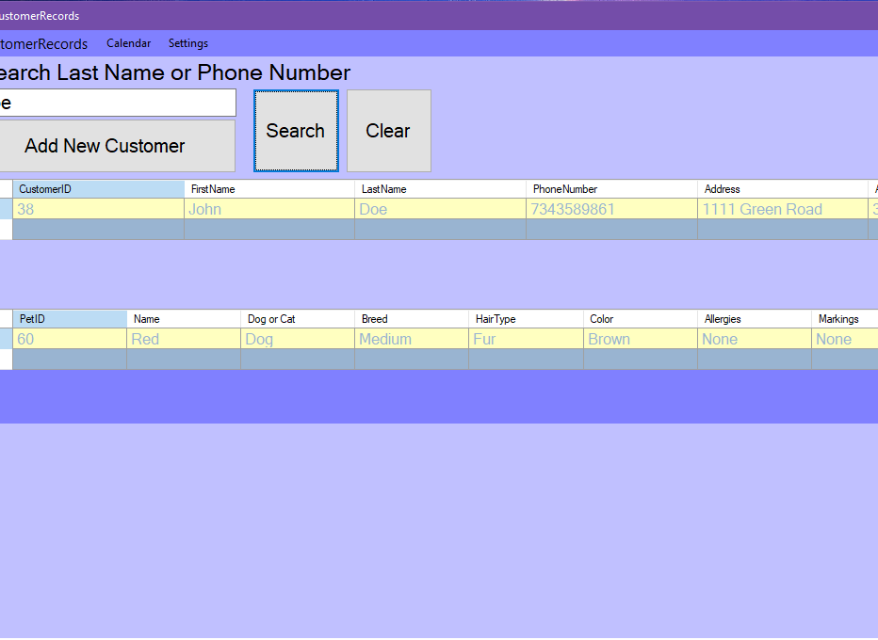
Search By Last Name

Slide 5
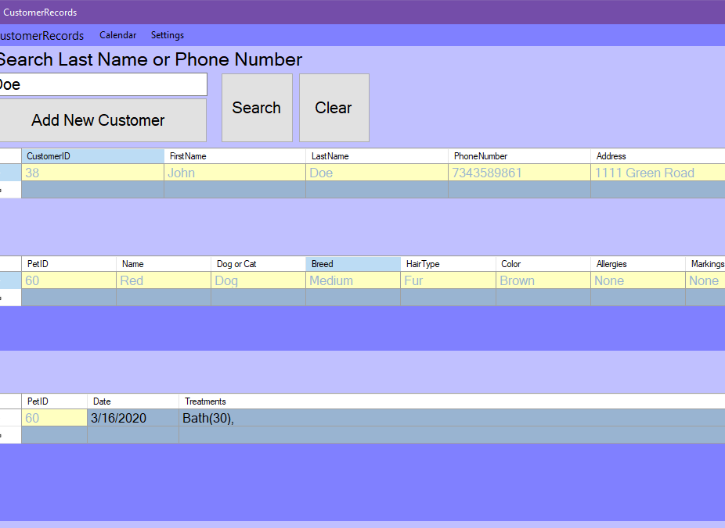
Double click a pet to see recent orders

Slide 6
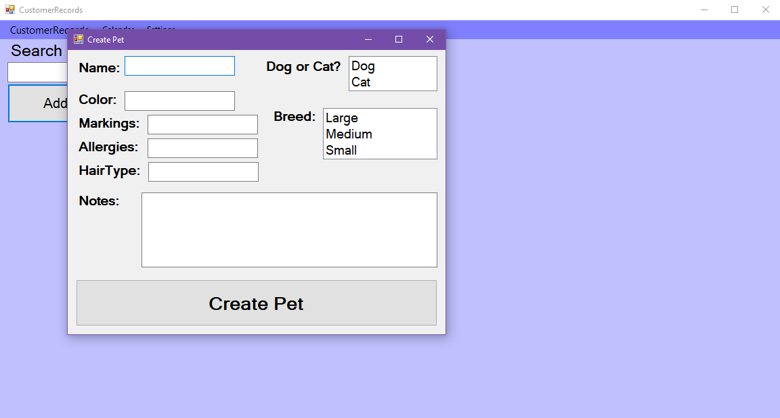
Create a new pet

Slide 7
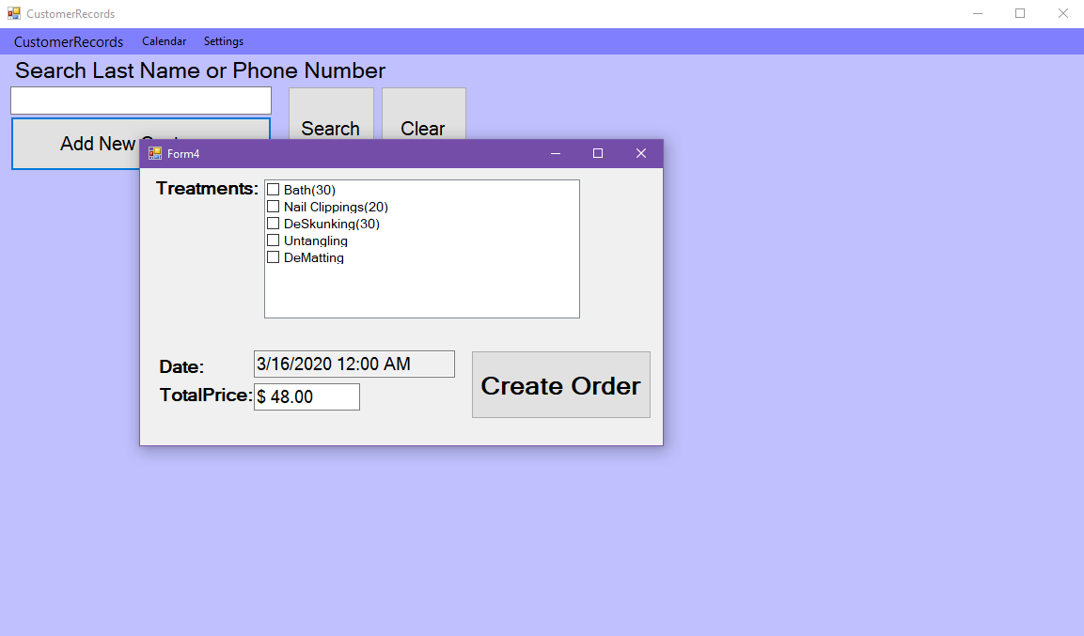
Creating a new order for a pet

Slide 8
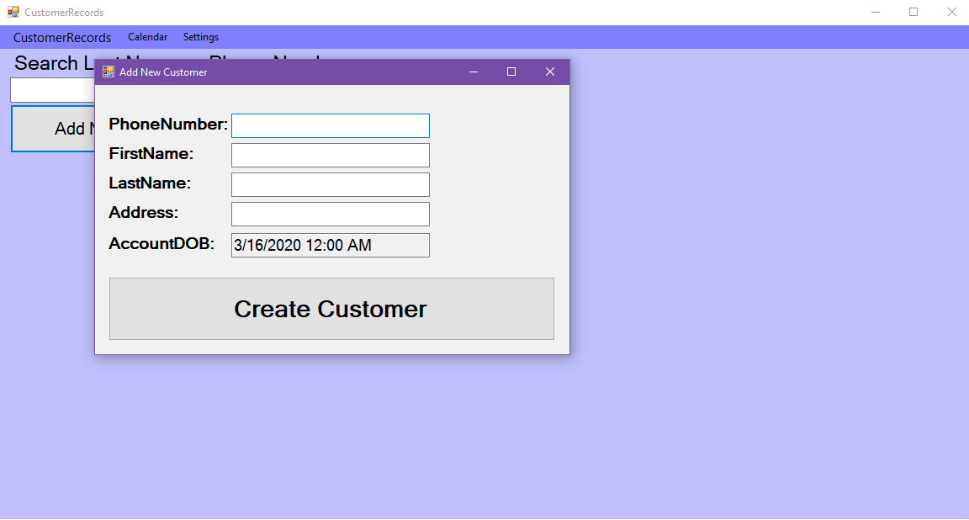
Creating a new customer in the database

Slide 9

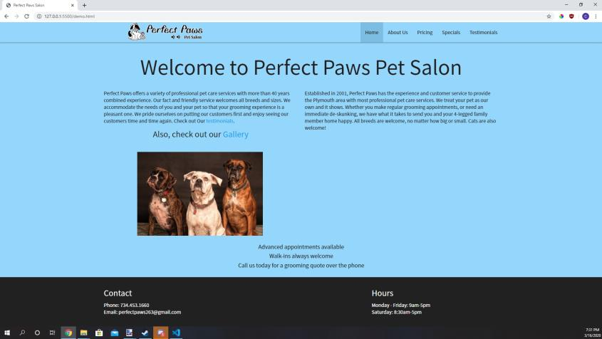
Adding a Modern Website Design

